Slide 1


The Power of Together

Slide 2
Antitrust Policy Notice
Linux Foundation meetings involve participation by industry competitors, and it is the intention of the Linux Foundation to conduct all of its activities in accordance with applicable antitrust and competition laws. It is therefore extremely important that attendees adhere to meeting agendas, and be aware of, and not participate in, any activities that are prohibited under applicable US state, federal or foreign antitrust and competition laws.
Examples of types of actions that are prohibited at Linux Foundation meetings and in connection with Linux Foundation activities are described in the Linux Foundation Antitrust Policy available at http://www.linuxfoundation.org/antitrust-policy. If you have questions about these matters, please contact your company counsel, or if you are a member of the Linux Foundation, feel free to contact Andrew Updegrove of the firm of Gesmer Updegrove LLP, which provides legal counsel to the Linux Foundation.

Slide 3
Antitrust Policy Notice
Linux Foundation meetings involve participation by industry competitors, and it is the intention of the Linux Foundation to conduct all of its activities in accordance with applicable antitrust and competition laws. It is therefore extremely important that attendees adhere to meeting agendas, and be aware of, and not participate in, any activities that are prohibited under applicable US state, federal or foreign antitrust and competition laws.
Examples of types of actions that are prohibited at Linux Foundation meetings and in connection with Linux Foundation activities are described in the Linux Foundation Antitrust Policy available at http://www.linuxfoundation.org/antitrust-policy. If you have questions about these matters, please contact your company counsel, or if you are a member of the Linux Foundation, feel free to contact Andrew Updegrove of the firm of Gesmer Updegrove LLP, which provides legal counsel to the Linux Foundation.
The Linux Foundation is a pre-competitive platform that enables cooperation and leveraged development.

Slide 4
Remove carbon from our power, buildings, and transportation systems to provide 75% of the reduction in CO² emissions that we need to stay below 1.5°C
Notes:
These are our marching orders.

Slide 5
Design Challenge
Not enough time
Not enough resources
We need interoperability
And, no vendor lock-in
Notes:
These are our marching orders.

Slide 6


Providing a 21st century plan of action to decarbonization through open source, open frameworks, reference architectures, and a support ecosystem of complementary projects.
Notes:
Talking Points:
- LF Energy is taking the power of Linux and focusing it on energy
But why do we exist?
Because in energy we now face similar conditions as those examples we discussed in the private sector.
We now must exist in an open source economy

Slide 7



























LF Energy Members
Strategic
General
Associate
Notes:
Source: https://landscape.lfenergy.org/pages/members

Slide 8


















LF Energy Projects (+1)
Notes:
Plus another 3 by the end of the month.

Slide 9



LF Energy Project growth
2018
2019
2020
2021
Notes:
Plus another 3 by the end of the month.

Slide 10

Forecasting Exponential Growth
OCPP Cloud Connector
100s of projects
R & D Sandboxes
A thousand members
10s of thousands of developers
2022
2023
2024
2025
Notes:
Plus another 3 by the end of the month.

Slide 11
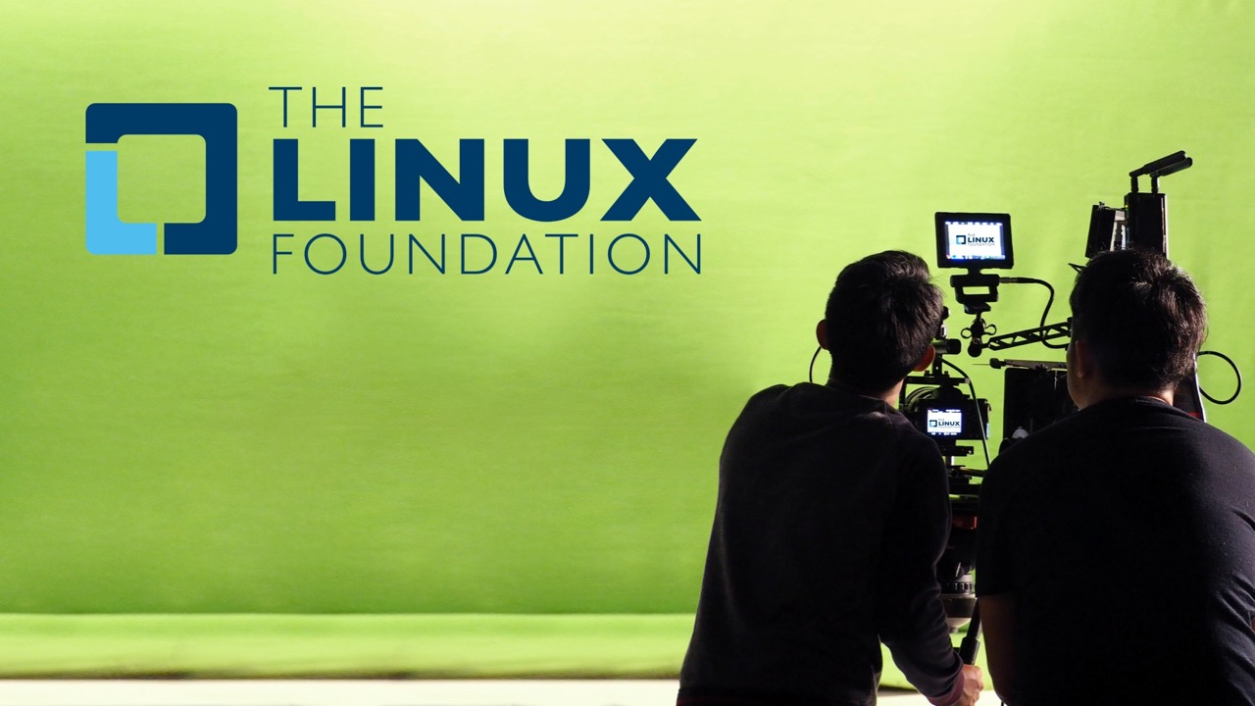
Notes:
Linux Has Grown into the Most Important open-source Platform in the World
To enable all of this the world has made two massive shifts:
Open source technology
Collaboration for non-differentiating layer
At the heart of the Linux Foundation is governance - a light-weight legal framework that enables joint investment. Separates business from technology. And through transparency, enables competitiors to work together in the open on creating the next paradigm.

Slide 12
Open Source
is simply defined as a permissive IP license that enables shared investment
and leveraged development

Slide 13



Today open source generally comprises 80-90% of a modern system’s total codebase
Use Open Source Libraries to Solve Problems Open Source Code (~70%)
Write Custom Code Custom Code (~10%)
Choose a Reference Implementation Open Source Code (~20%)

Slide 14







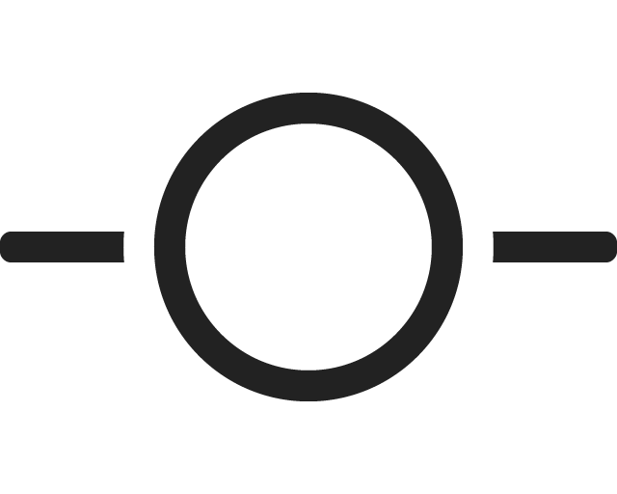











Hundreds of monitored projects, 1B lines of code
24.4M
Lines of Code Added Weekly
14.4M
Lines of Code Removed Weekly
722,330
Technical Contributors
118,556
Ecosystem
Contributors
12,925
Contributing
Companies
12,899
Repositories
12.2M
Commits
1.4M
Pull Requests
2.1M
Builds Monitored
933,150
Logged Issues
11.2B
Container Downloads
236,499
Vulnerabilities Detected
4.4M
Email Messages
5.1M
Chat Messages
32,517
CLA Contributors
82,939
Event Attendees
(12 months)
1100+
Project Domains
28,028
Community Meetings

Slide 15
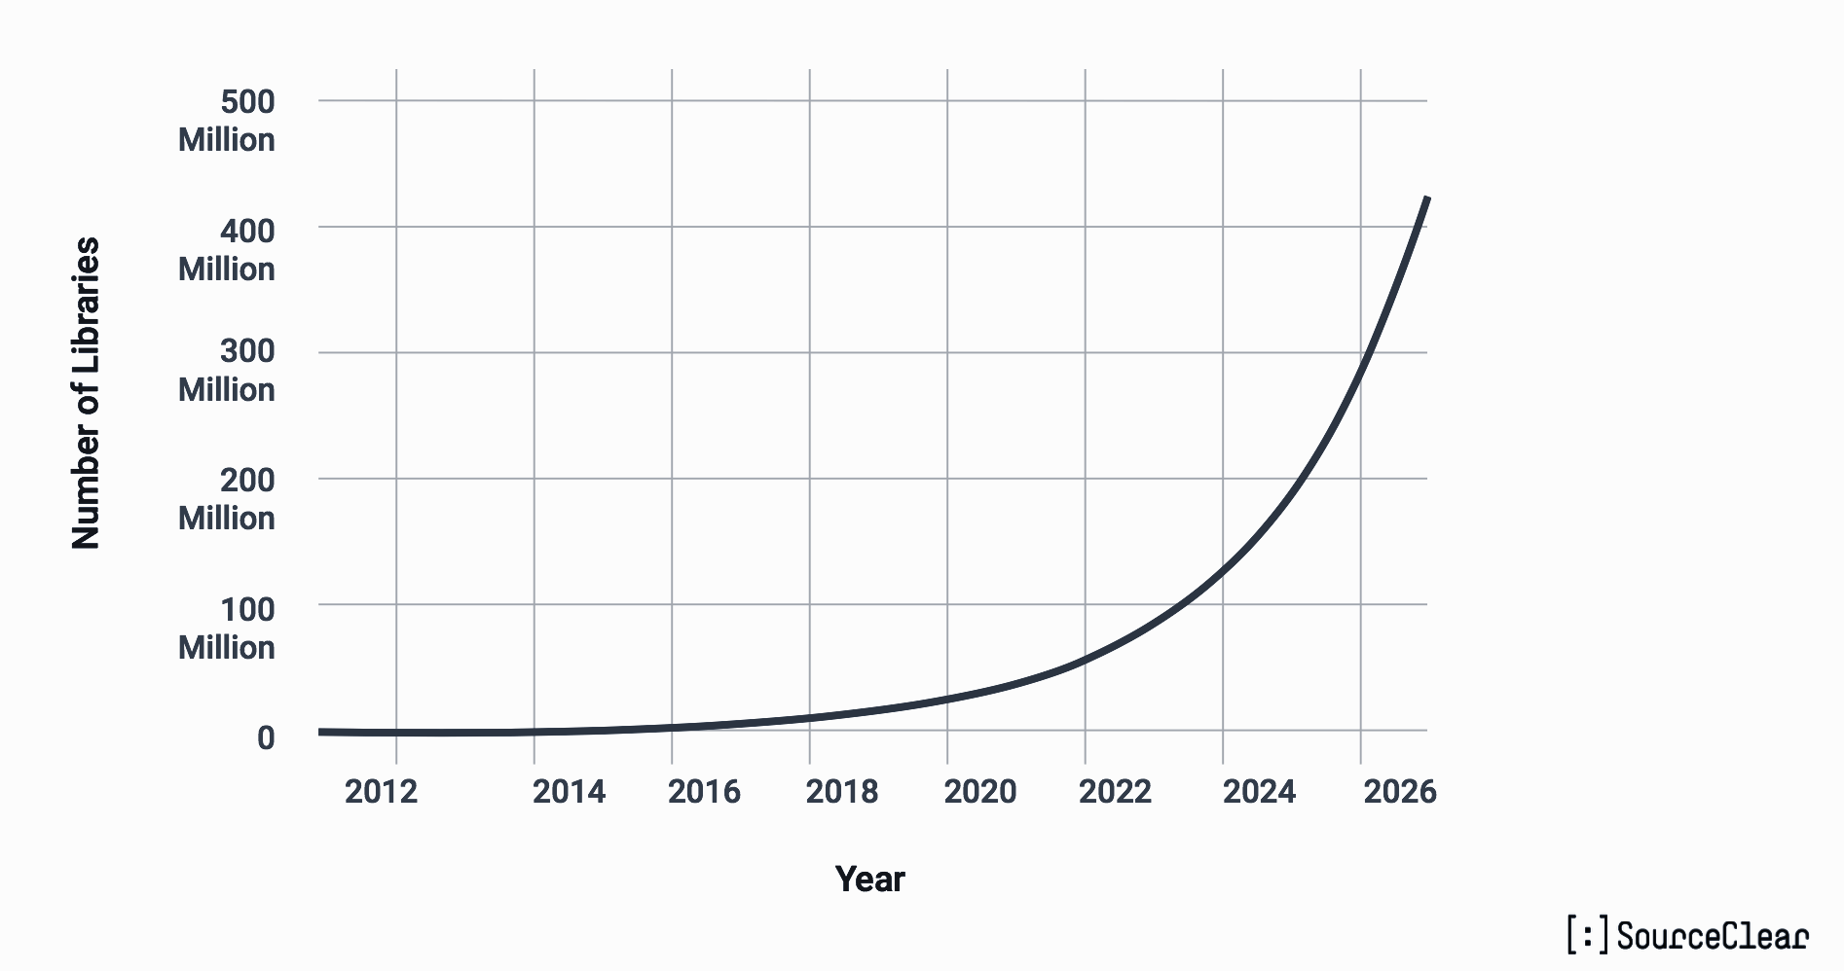
Open Source is on an exponential growth curve, developers use it as a universal building block for production systems

Slide 16
There are millions of open source projects and growing. But not all projects are the same
Value of Individual Project
Number of Open Source Projects

Slide 17
Projects that are critical to society and industry need healthy, neutral ecosystems
Value of of Individual Project
Build Ecosystems
Number of Open Source Projects

Slide 18


Our goal is to ignite a positive feedback loop of sustainability
PROJECTS
Successful projects depend on members, developers, standards, and infrastructure to enable commercialization pathways that the market will adopt
DEVELOPER
COMMUNITY
TECHNOLOGY
PARTICIPATION
MARKETS
PRODUCTS
PROFITS
PRODUCTS

Slide 19
The Linux Foundation provides unparalleled ecosystem support
Support and Resources
Community/Responsive
Slack/IRC
Email
Stackoverflow
IT operations/Release Mgmt
Value
Self Service
FAQ
Forum
Knowledgebase
Onboarding
Define problem project/code solving
Recruit widely deployed projects/communities
Curate projects with natural adjacency to existing project
Demonstrate where project fits in to broader tech innovation
Neutral Management
IT Beyond Version Control
Provide home for IP assets
Define a governance structure for decisions
Separate business decisions from technical
Curate sense of identity superseding individuals or firms
Maintain IT infrastructure
CI/CD technical architecture design
CI environment delivery
Release engineering services
Project planning, build & system go-live
Delivery of project collaboration solutions, domain registrations & websites
Marketing Programs
Developer Recruitment and Relations
Advocate/Influence Programs
Rewards/Recognition
Startup/Incubator Engagement
Student programs
PR/AR
In person
Meetups
Events
Hackathons
3rd Party Events
Evangelism
Online
Email lists and calls/meetings
IRC/Slack
Github, Gitlab, etc.
Stackoverflow
3rd party repos
Content
Technical
Code samples
Getting started guides
How to’s/FAQ
API/SDK
Research
Use cases/Case Study
Whitepapers
Blogs
Webinars
Articles
Training
Engage
Massive Open Online Course (EdX)
Webinars
Snackable learning
Train
eLearning
Classroom learning
Subscription learning
Certify
Skills based testing
Ongoing engagement

Slide 20




















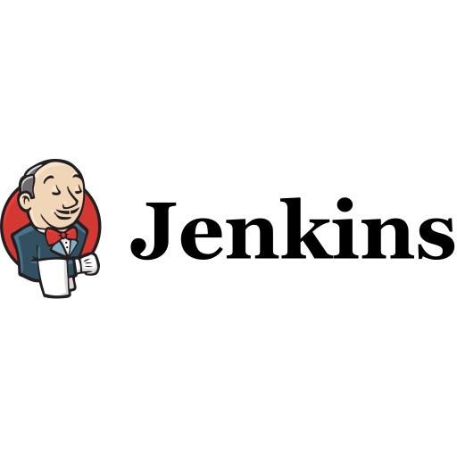



















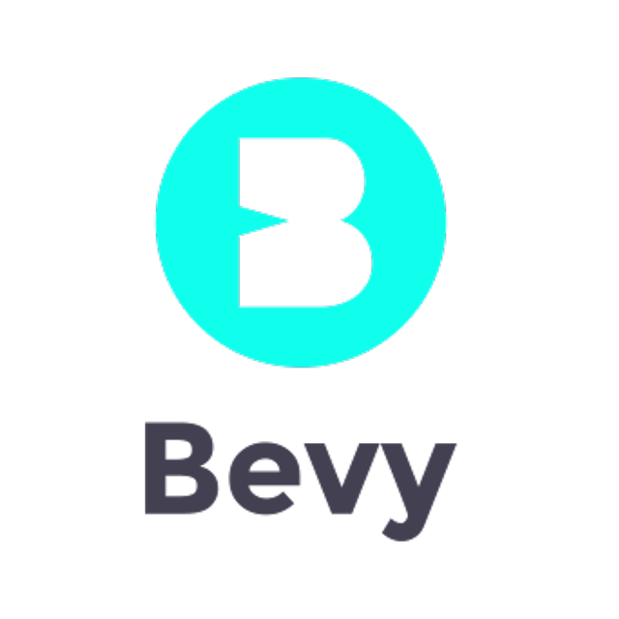








What enables our success is the LFX platform - designed from the ground up for scale and extensibility
Enterprise Tools
Development
Security
Operations
API Bridge Upstream and Downstream
Funding
Growth & Adoption
Crowdfunding
Member Enrollment
Talent Management
Organization Dashboard
Mentorship
Training & Certification
Application Security
Community Identity
Community Management
Security (Code Secrets, Vulnerabilities, Non-Inclusive Language)
Individual Dashboard
Branded Meetup/Events
Community Analytics
Meeting Management
Health & Analytics
Community Operations
Insights (Technical, Ecosystem, Marketing)
IP Management
Project Control Center
EasyCLA
SBOM Generator
CONNECTORS
API Metrics and Workflow Data
Developer & Community Tools

Slide 21
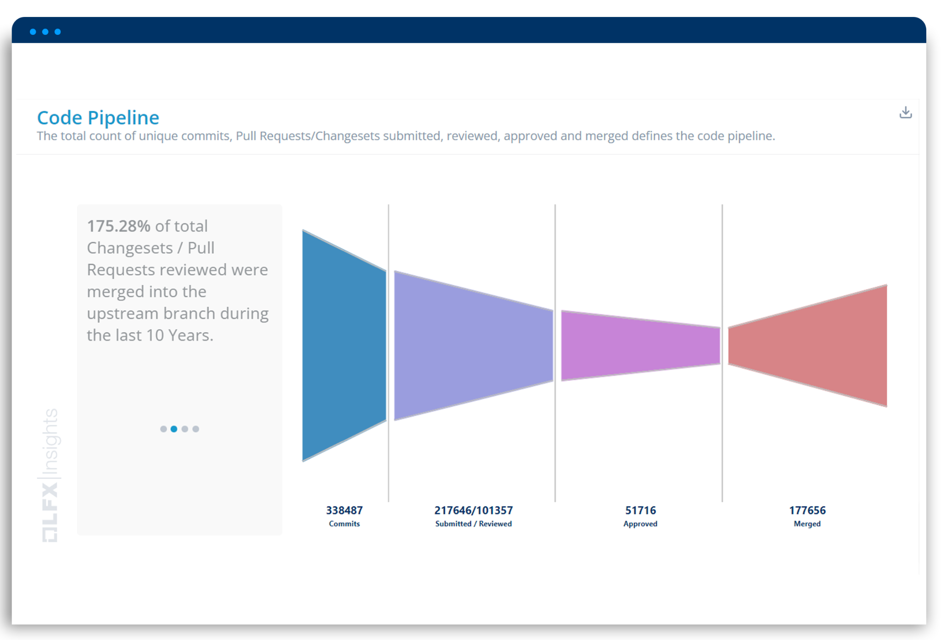
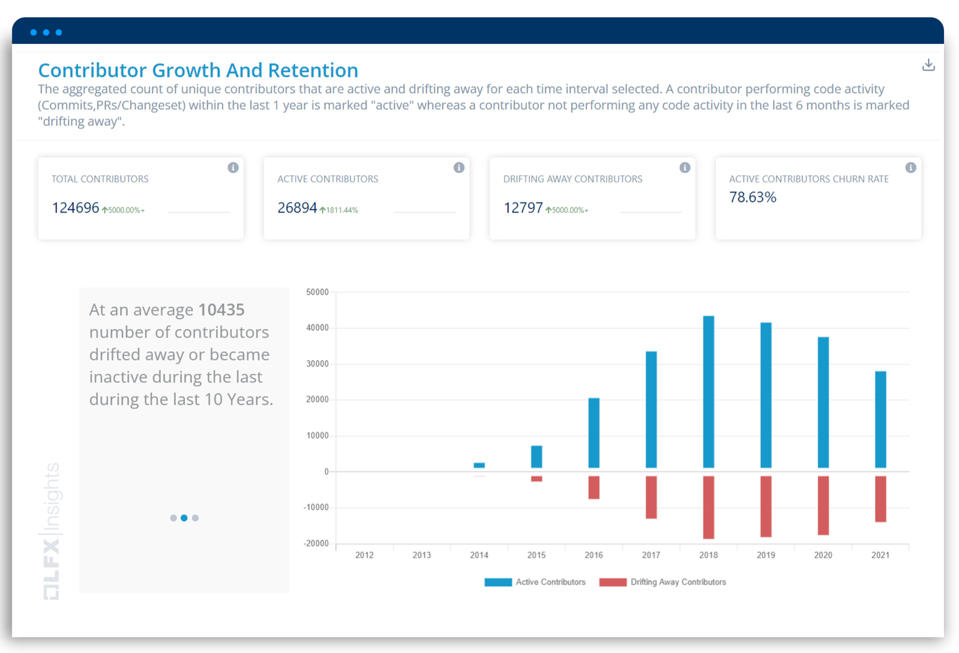

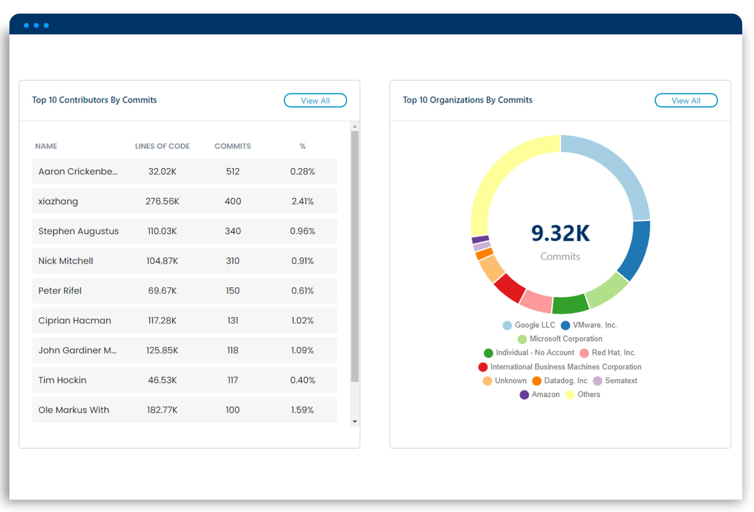
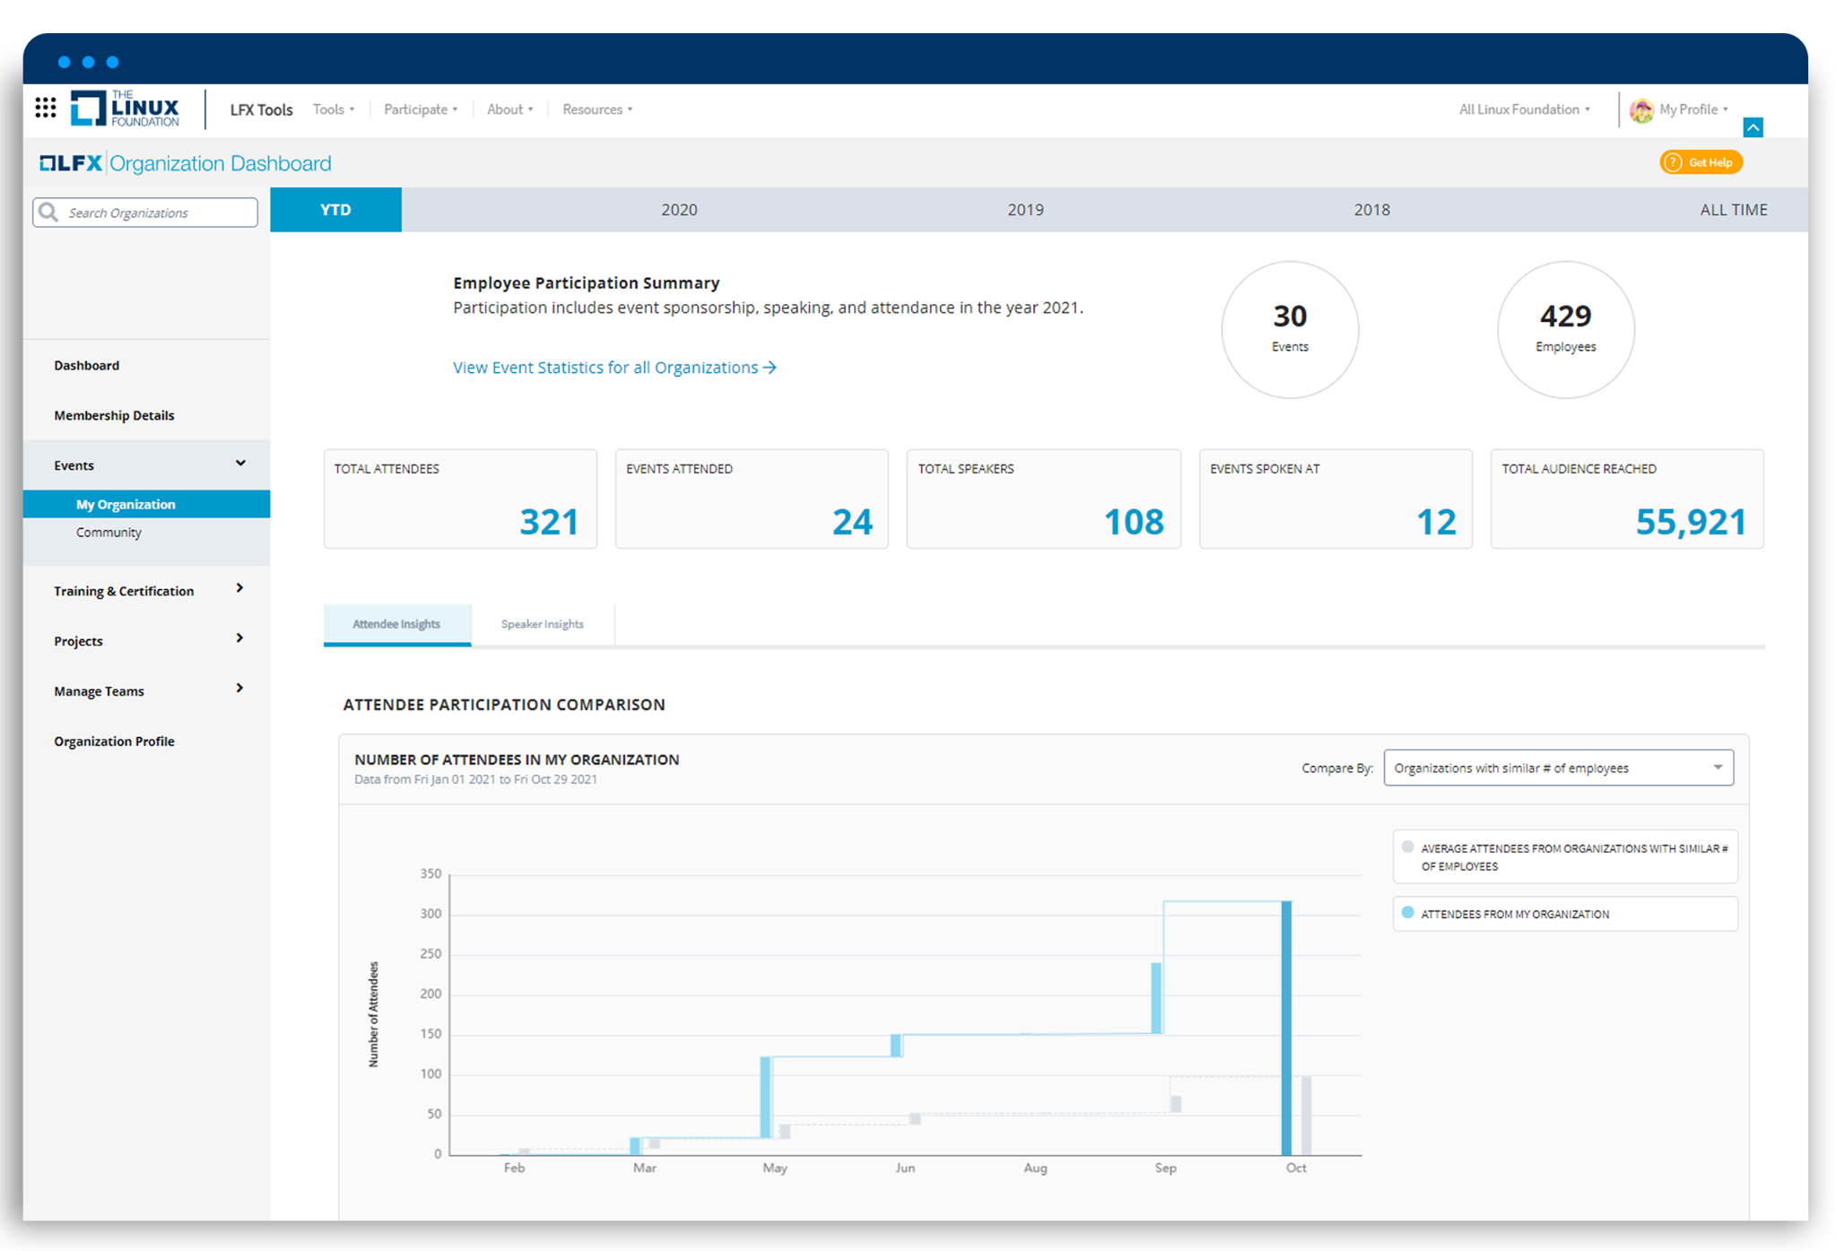
Focused on impact & outcomes while being non-intrusive to development process
Identify developer pipeline bottlenecks
Measure and reduce contributor churn
Benchmark against leaders
Measure reach at events
Analyze social media outreach
Drive investments to improve security
API Metrics and Workflow Data
Developer & Community Tools

Slide 22
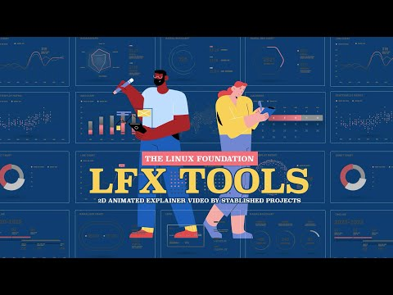
Watch this short overview video on LFX

Slide 23
Our highest concern?
Institute tooling that supports secure coding practices

Slide 24



What impacts code security?
Most project maintainers are not security experts
Project Maintainers simply do have the time to focus on code security – which includes finding and fixing vulnerabilities
Identifying and activating the security engineers needed to address code vulnerabilities is very difficult for most Project Maintainers.
Maintainers understand that code security is important – but priority is given to project functionality and not on a mature security posture.

Slide 25
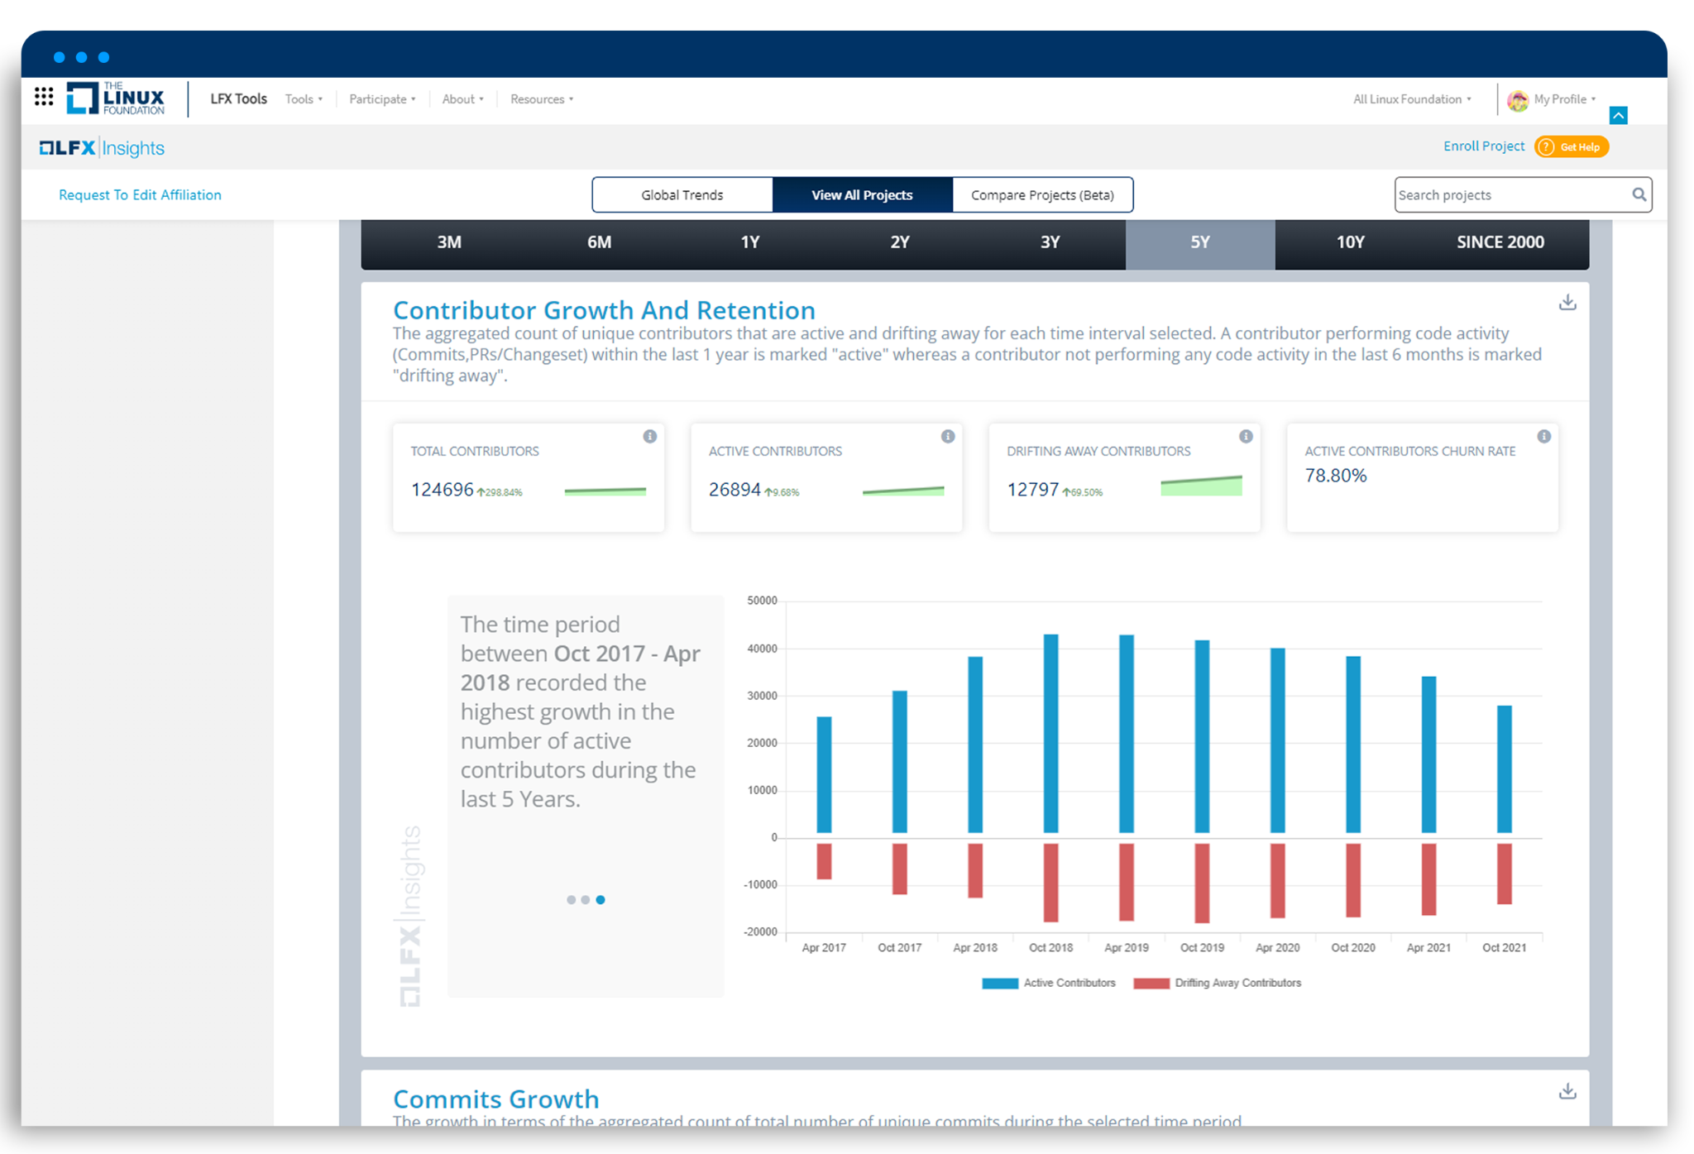
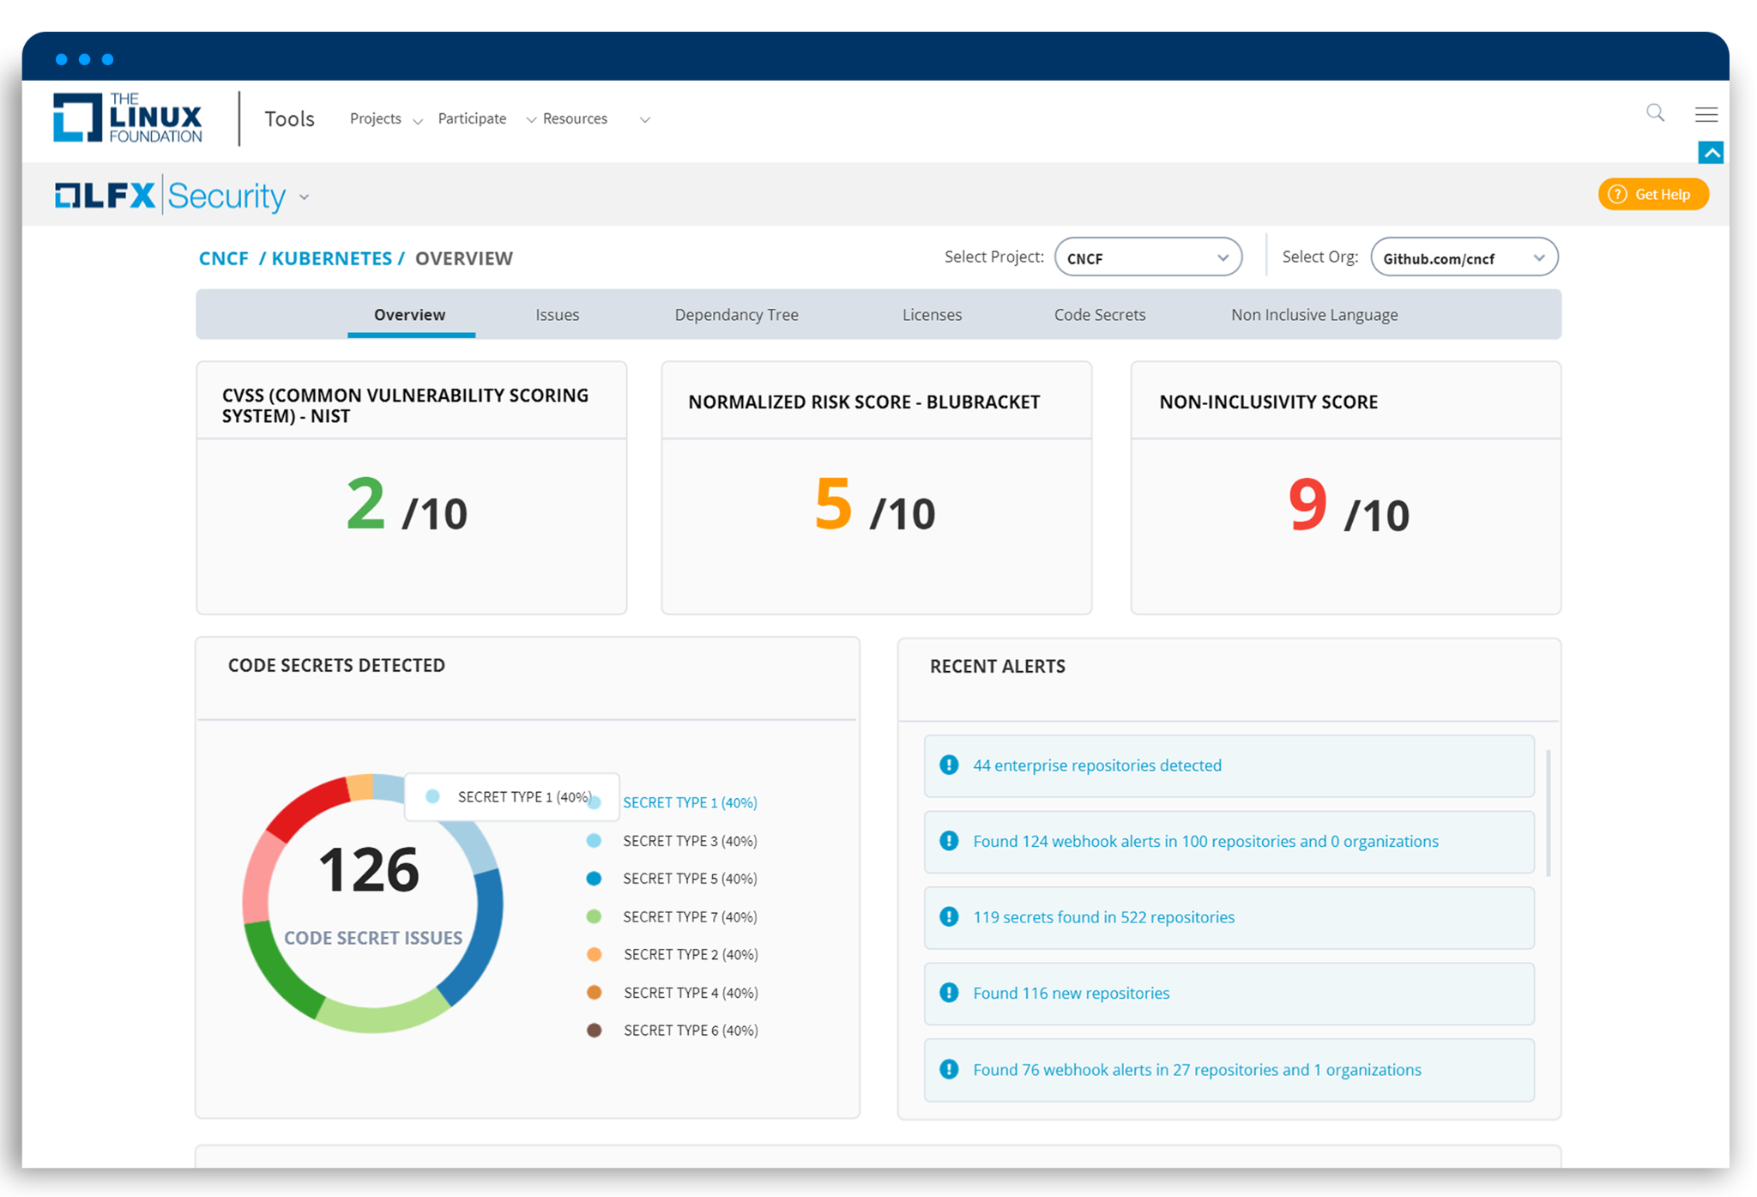
How we are addressing this challenge with LFX?
Determine Criticality
LFX Insights
Prioritize Real Issues
LFX Security
Drive Results With Investment
LFX Crowdfunding

Slide 26

Through LFX Security, LF Energy leads with Secure by Design
OpenSSF - LFX Security Hub
Maintainers / Security Devs
Governance Groups / Supporters
Triage Portal
Reports Portal
Dev
Pipeline
Integrations
Distributed Identity, Access and RBAC
LFX Data Lake
LFX Insights (Code & Ecosystem Metrics)
LFX Connector Layer
Snyk.io
(vulnerabilities)
Blubracket
(Code Secrets)
CII Badging
(Best Practices)
Scorecards
(Criticality)
CodeQL
OSS Fuzz
SBOM Generators

Slide 27
Watch this short video on LFX Security
https://drive.google.com/file/d/1u4QwvZeWVAN6AiYP42B7wp9DUAmu4NDW/view?usp=sharing

Slide 28

The LF Energy ecosystem alleviates the cost, risk and stagnation of isolated solutions.
We take you beyond “black boxes”.
Notes:
Talking Points:
Reduces cost, risk and the damage caused by isolation.
Collaborate on the 80% that doesn’t differentiate and demands the most of your resources
Focus on the 20% that truly moves you forward and allows you to innovated for your stakeholders and customers

Slide 29
Isolation and going it alone are no longer viable.
Notes:
Talking points:
There once was a time when it made sense to build a fortress around your business
It was safer, easier, cheaper and you had most of the resources your needed
It’s not affordable or feasible anymore
These companies and hundreds of others have recognized this and are now collaborating for the first time

Slide 30
We need speed, scale, enhanced security, accelerated innovation, and global talent.
Notes:
Talking points:
While the most credible ideas for the future may seem ridiculous today, they saw a need for tangible progress:
They understood they needed to move faster, drive greater impact, with heightened security to accelerate innovation- while having the right talent.

Slide 31

We need mass collaboration.

Slide 32
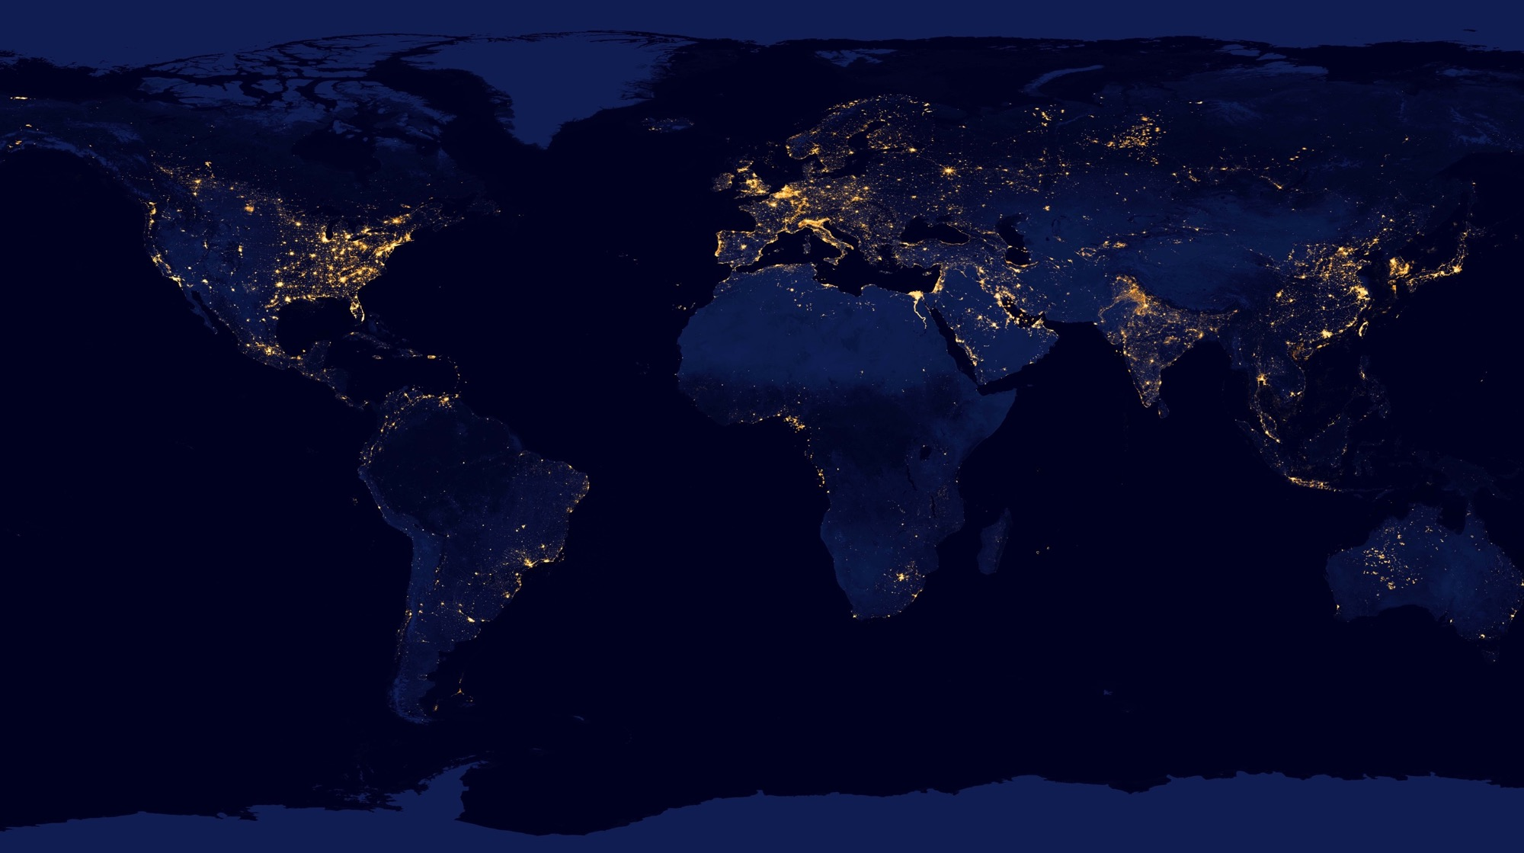

OUR COMMITMENT
To achieve our climate and energy transition goals we have joined together to create a common functional architecture defining a fit-for-the-future grid. Our goal is a common understanding of required functional capabilities. The architecture starts with a top-level view and progresses to a finer granularity. The final slide shows existing and near-future LF Energy projects fits into this architecture.
This is a start. We want your feedback and involvement. With this we proclaim a commitment under LF Energy to find shared strategic dependencies. By utilizing open source we can accelerate a technology revolution that enables rapid decarbonization by digitalizing the global energy grid. We see that cooperation and working together is the only path to individual and collective success.
Join us.

Slide 33
CUSTOMER & MARKET
SYSTEM MANAGEMENT
Capabilities related to customer and markets and other third parties
Capabilities related to managing the physical flow and balance of a power system
This is the top-level view that shows the five main “blocks” of the functional architecture that we also call categories.
Capabilities that are required by each of the other categories
SHARED
Capabilities related to monitoring and controlling your assets on the grid
Capabilities related to managing your assets
ACQUISITION AND CONTROL
LFE High-Level Functional Architecture V1.0 - CC 4.0
ASSET MANAGEMENT
Notes:
What follows is a three level taxonomy. A mental model of the grid of the future.

Slide 34
CUSTOMER & MARKET
SYSTEM MANAGEMENT
METERING & COMPENSATION
The capabilities related to engaging with customers, markets and other third parties
The capabilities related to managing the physical flow and balance of a power system
CUSTOMER RELATIONSHIP & COMMUNICATION
CUSTOMER RESPONSE
MARKET PLATFORM GATEWAY
MARKET SIGNAL
SYSTEM CONTROL
POWER SYSTEM CALCULATION
FORECASTING
DATA MANAGEMENT
SYSTEMS GOVERNANCE
IT MANAGEMENT
SUPERVISION
COMMON COMMUNICATION MEDIA
EDGE NODE CONTROL
OUTAGE MANAGEMENT
ASSET INVESTMENT PLANNING
SHARED
The capabilities that are required and shared by each of the other categories
LESS CRITICAL EQUIPMENTS
SECURITY MANAGEMENT
UNIFIED OPERATOR’S UX COMPONENTS & FRAMEWORK
AGGREGATION
NODE
CENTRAL HUB
SUBSTATION
NODE
ASSET REPOSITORY
ASSET SUPERVISION
ANALYTICS
FIELD WORK MANAGEMENT
DISTRIBUTED
NODE
COMMUNICATION INFRASTRUCTURE
CRITICAL EQUIPMENTS
INFRASTRUCTURE MANAGEMENT
EQUIPMENT
NODE
The capabilities related to monitoring and controlling your assets on the grid
The capabilities related to managing your assets
EQUIPMENT
NODE
ACQUISITION AND CONTROL
LFE High-Level Functional Architecture V1.0 - CC 4.0
ASSET MANAGEMENT

Slide 35
This is the framework for the LF Energy Application Catalogue
CUSTOMER & MARKET
SYSTEM MANAGEMENT
CUSTOMER RELATIONSHIP & COMMUNICATION
Acquisition, system design, pricing
Notification & communication management
Emergency & crisis management
Customer app/UX/UI
Contract
Consent management
METERING & COMPENSATION
Metering
Compensation/ Settlement
Billing
CUSTOMER RESPONSE
Smart Ledgers
Smart contract
Customer Preferences
MARKET PLATFORM GATEWAY
Power Exchange
Capacity platform
Balancing market
Availability
Cross border capacity
Services
MARKET SIGNAL
Cross border capacity calculation
Adequacy assessment
Balancing mechanisms
Aggregated service organization:
generators / Storage / site optimization
SYSTEM CONTROL
Remote operation
System automation
centralized automation
power quality and system stability
autonomous function conf
Schedules
POWER SYSTEM CALCULATION
Modeling
Model exchanges
State estimation
Simulation
static & dynamic calculation
security analysis
dispatch / adequacy calculation
FORECASTING
Area Demand
Solar/Wind Resource
Generation
System services
Local/site balance
International Exchange
Market prices
DATA MANAGEMENT
Long term storage
Message queues
Data validation
DATA MANAGEMENT
Long term storage
Message queuing
Data validation
Privacy mgt
SYSTEMS GOVERNANCE
Self-registering
Self-healing
Alignment with regulations and standards
IT MANAGEMENT
SUPERVISION
Network administration
Service administration
Threat Monitoring
COMMON COMMUNICATION MEDIA
Emergency & crisis management
Message queuing – services, directory
EDGE NODE CONTROL
Protocol conversion
Aggregated / distributed / local automations:
synchronization
Balance & frequency control
Monitoring & control
Congestion mgt
Power quality mgt
Outage mgt
Storage mgt
Demand response mgt
Aggregated / distributed / virtualized equipment protections
Failures recording
Measuring, metering , altering, sensing & actuation
Logging
Configuration
Equipment communication
OUTAGE MANAGEMENT
Ticketing
Outage Programming and planning
Customer impact assessment
Outage coordination & stakeholder mgt
Distributed outage management
ASSET INVESTMENT PLANNING
Renewal policy management
Investment policy
Project finance mgt
SHARED
LESS CRITICAL EQUIPMENTS
Sensor | Protection | Actuator
SECURITY MANAGEMENT
Cybersecurity
Privacy mgt
UNIFIED OPERATOR’S UX COMPONENTS & FRAMEWORK
Animated power substation/ network schemes
Supervision / Hypervision component
User alerting
Coordination and workflow framework
Field Services, Customer Care
AGGREGATION
NODE
CENTRAL HUB
Protocol conversion
Cross-device / vendor & cross-telecom network compatibility
Data acquisition and treatment
Short term persistency
End to End Encryption / KEYs
SUBSTATION
NODE
ASSET REPOSITORY
Power equipment repository
Digital infrastructure repository
Configuration tools
Configurations and settings repository
DBoM/SBoM
ASSET SUPERVISION
Real time monitoring
Log analysis
Asset performance management
Asset planning
Asset lifecycle mgt
ANALYTICS
Health index computation
Digital twin
Predictive analytics
Deep learning
Simulation
FIELD WORK MANAGEMENT
Safety rules implementation
Team planning + scheduling
Supply chain
CRITICAL EQUIPMENTS
Sensor Protection Actuator
DISTRIBUTED
NODE
COMMUNICATION INFRASTRUCTURE
EQUIPMENT
NODE
INFRASTRUCTURE MANAGEMENT
Remote equipment and node mgt.
Remote configuration mgt.
Commissioning & installation mgt
CUSTOMER SIDE
NODE
ACQUISITION AND CONTROL
LFE High-Level Functional Architecture V1.0 - CC 4.0
ASSET MANAGEMENT

Slide 36

Business Intelligence
Application
Catalogue
Central Supporting Services
SECURITY
Data &
Services
Edge & Distributed Intelligence
Infrastructure

Slide 37








Business Intelligence/
Application Catalogue
Uniform HMI
Application
Catalogue
Flexibility Trading
Capacity Mapping
Power System
Automation
Architecture
Short-Term Forecasting
Energy Services
NMEC and Avoided Energy Use
Power System
Calculation
Block
Market Clearing & Settlement
Core Business Supporting Services
Data Exchange Gateways
IoT Platform
Operational and IoT Data Storage (SCADA, PMU, Sensor)
Network Model Manager
Configuration & Validation Tools
CGMES
CIM
BD4NRG
Roles/
Responsibilities
More
61850 Substation Configuration
Data &
Services
SECURITY
Network Security Coordination
Markets
SO Data Exchange
Alarm Management
Data Model
Sargon
IEC61850
(Topology models and processes)
Core Business
Supporting
Platforms
API (standard interface for accessing and storing the data)
REAL TIME Event Orchestration Layer (Kafka, MQTT, ONAP? etc) [analysis]
Data and Services Platforms - FIWARE, TimeScale Db, DataBricks, homemade
Edge & Distributed Intelligence
Multiprotocol Gateway
Substation Automation & Virtualization
EV Gateway
Demand Response
DC Microgrid
Infrastructure
Constrained Device Edge
Smart Device Edge
On-Prem Data Edge
Operator Network Edge
Regional Network Edge
For more background on Edge see this.
End-User EDGE - Dedicated Operated
Utility Service Provider EDGE - Shared, XaaS
Notes:
2021 progress
filling out the map
made progress
new projects in 2021
Project maturity
cloud native (on-prem or not), not monolithic platform (LFEdge, Networking, CNCF)

Slide 38
Better security practices in projects
2020
2021
2022
OpenSSF Badging introduced to all existing projects
2. Project Lifecycle strengthened to require OpenSSF Badges at different stages
Incubation: Passing
Early Adoption: Silver
Graduated: Gold
3. License Scanning Service added with all projects having SBOMs built on a regular basis
4. LFX Security and Insights enabled for all projects
5. Focus on project maturity, which will bring projects to have higher levels of OpenSSF badges
6. Third-party security audit funding for Graduated Project (pending funding)

Slide 39
LF Energy can host three sorts of projects
Open Source software
Open specifications using either the Joint Development Foundation framework or the Community Specification 1.0
Open hardware design using the Community Specification 1.0

Slide 40
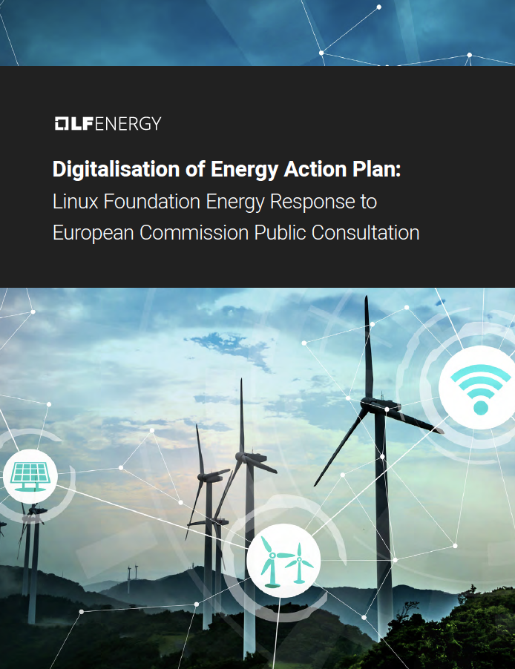
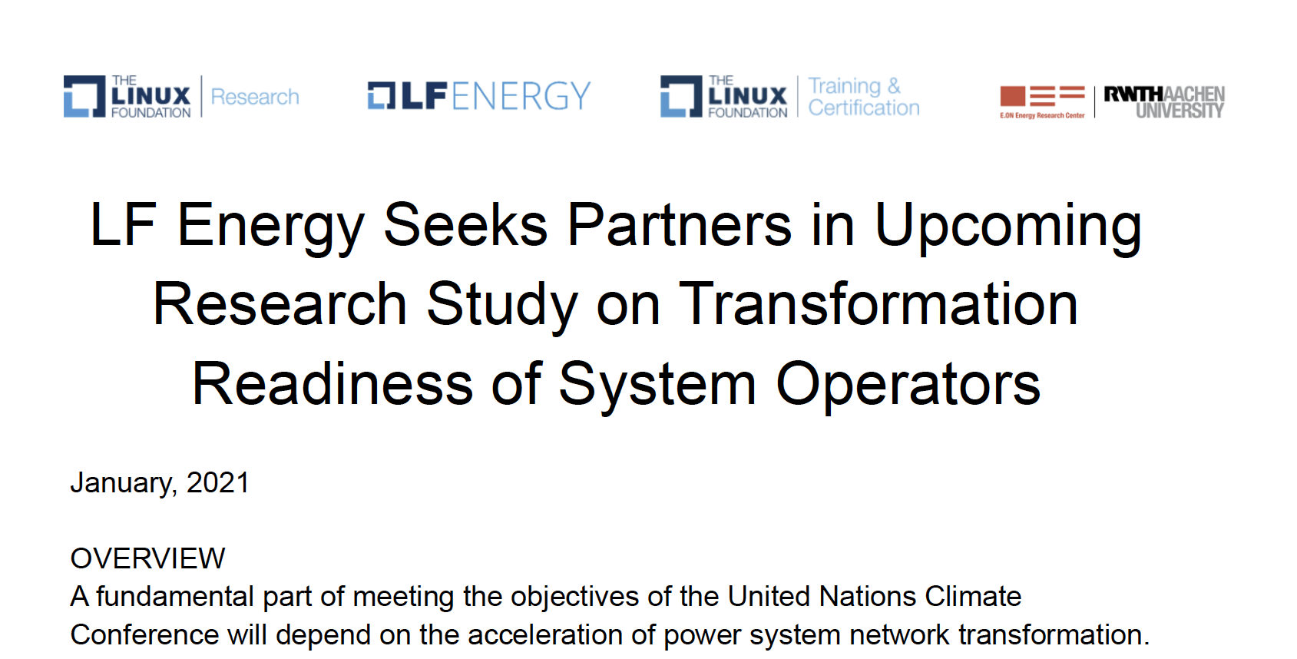
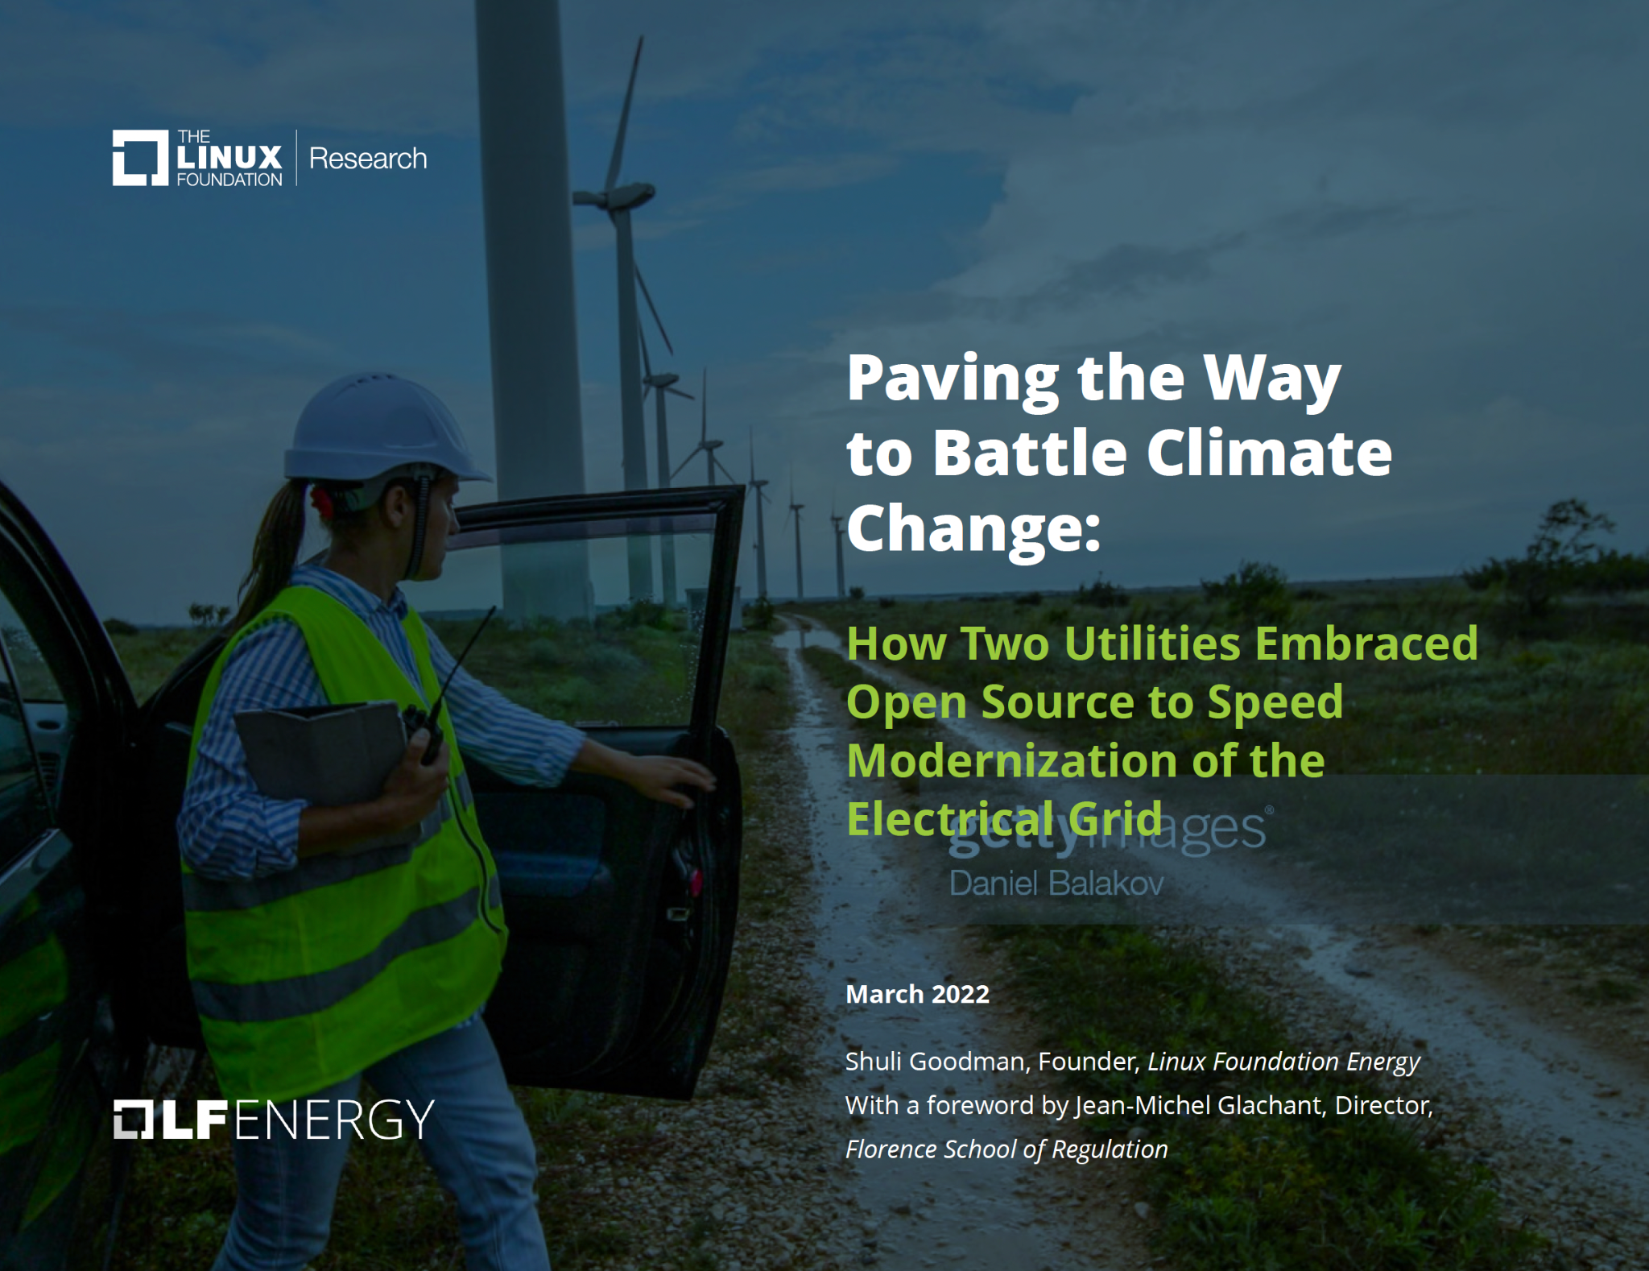
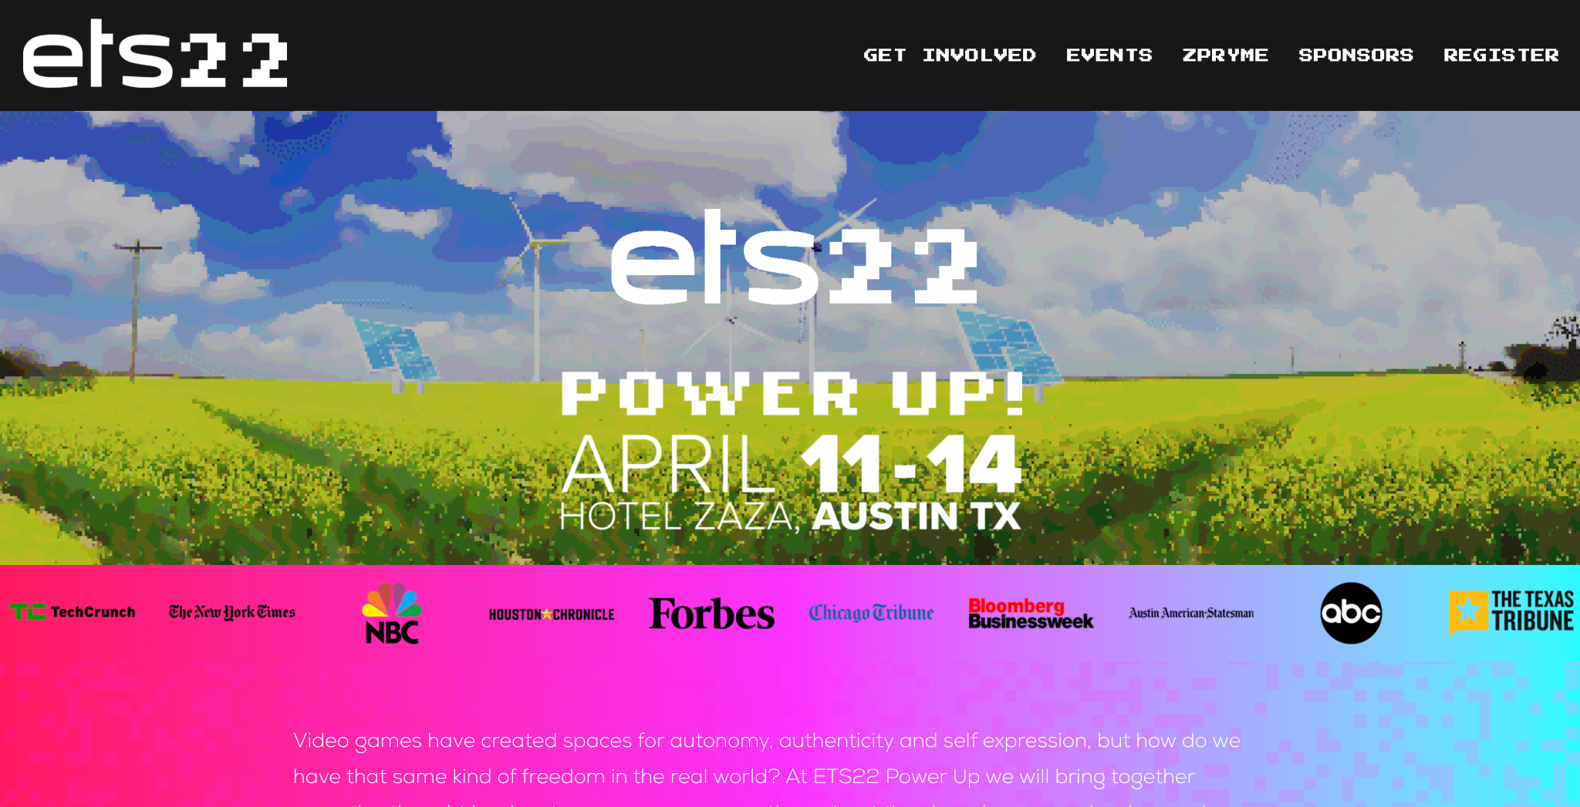
Other areas of focus - research, training, case studies, policy

Slide 41
Governance

Slide 42
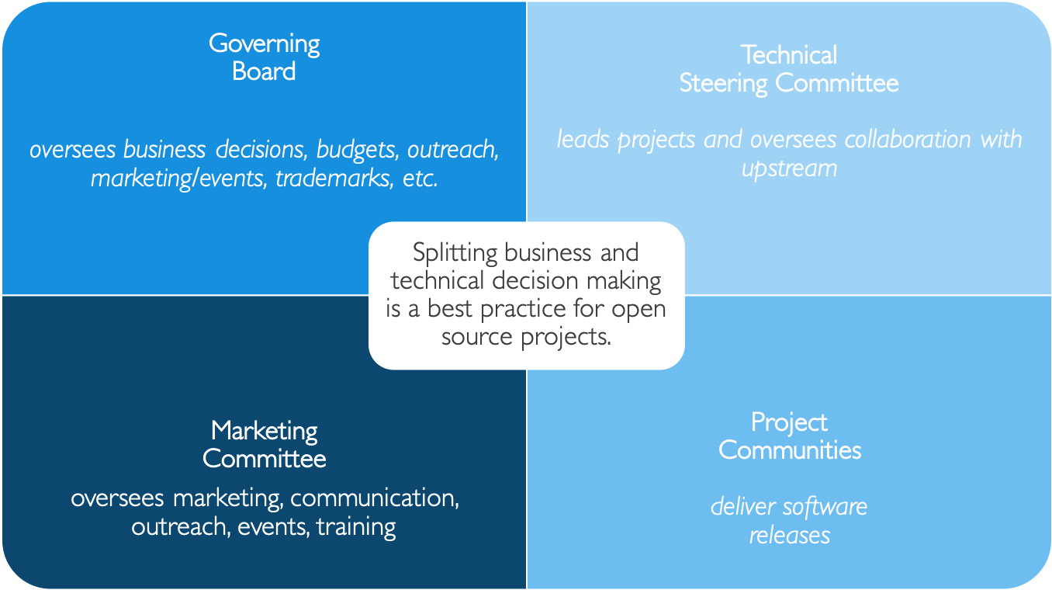
At the heart of LF Energy is Governance

Slide 43
LF Energy Governance in Roles
A Technical Steering Committee (TSC) oversees each project. Each TSC has an elected Chair who both leads a project TSC and represents the concerns of a project to the Technical Advisory Committee (TAC). Participation on the TSC is based on merit, expertise, and contribution to the code or artifacts (e.g. testing, documentation) of the community.
Strategic Members can appoint 1 representative to a TSC for an initial 6-month basis to jump start engagement
Membership on a TSC thereafter is based on technical contribution—e.g., contributing a new project
A Technical Advisory Committee (TAC) addresses technical community concerns such as: new projects, release planning, cross-project collaboration, and documentation practices. The TAC is composed of the Chairs for each project TSC, plus a Governing Board representative to ensure alignment between technical and business concerns. There is an elected TAC Chair who represents the technical community on the Governing Board.
Strategic Members can appoint one voting representative to the TAC
Each project from Early Adoption has one vote on the TAC
The Governing Board (GB) is limited to Strategic members and the elected TAC Chair. The GB determines allocation of funding to priorities and provides members with control over where their funding goes.
Strategic Members each appoint 1 representative
General Members can elect 1 representative for every 10 General Members, up to 3 total
Governing Board establishes additional committees to address topics (e.g. legal, marketing, budget)

Slide 44
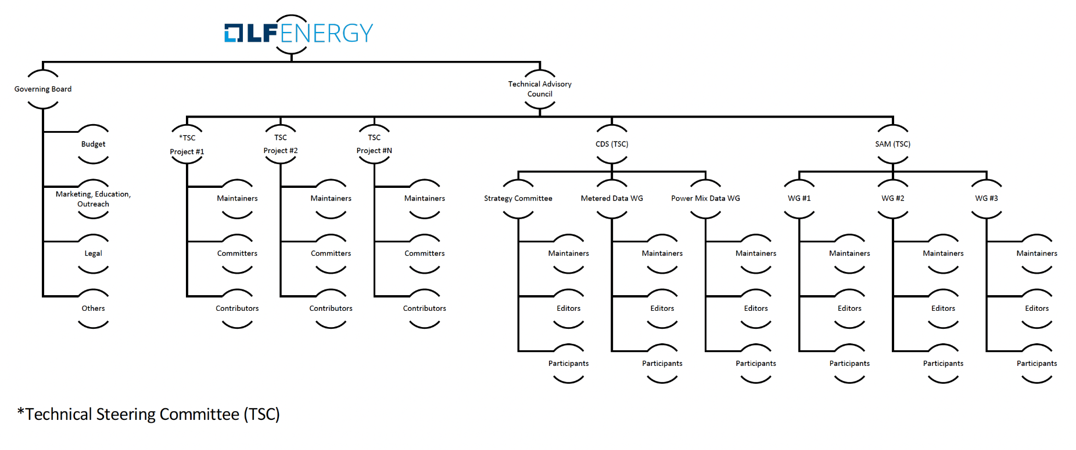
Governance model

Slide 45
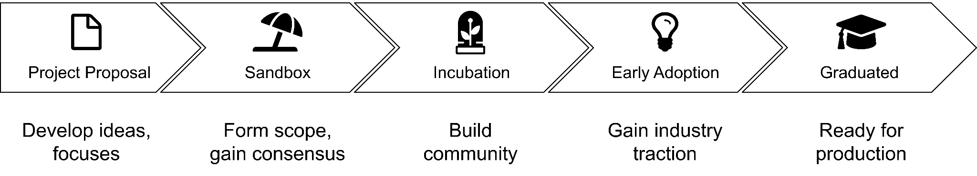
LF Energy project lifecycle
Projects can become part of LF Energy through the submission of a mature code base.
Projects can also be formed through special interests groups that submit a proposal and then form as an incubation project.
Learn more at https://www.lfenergy.org/host-your-project/

Slide 46
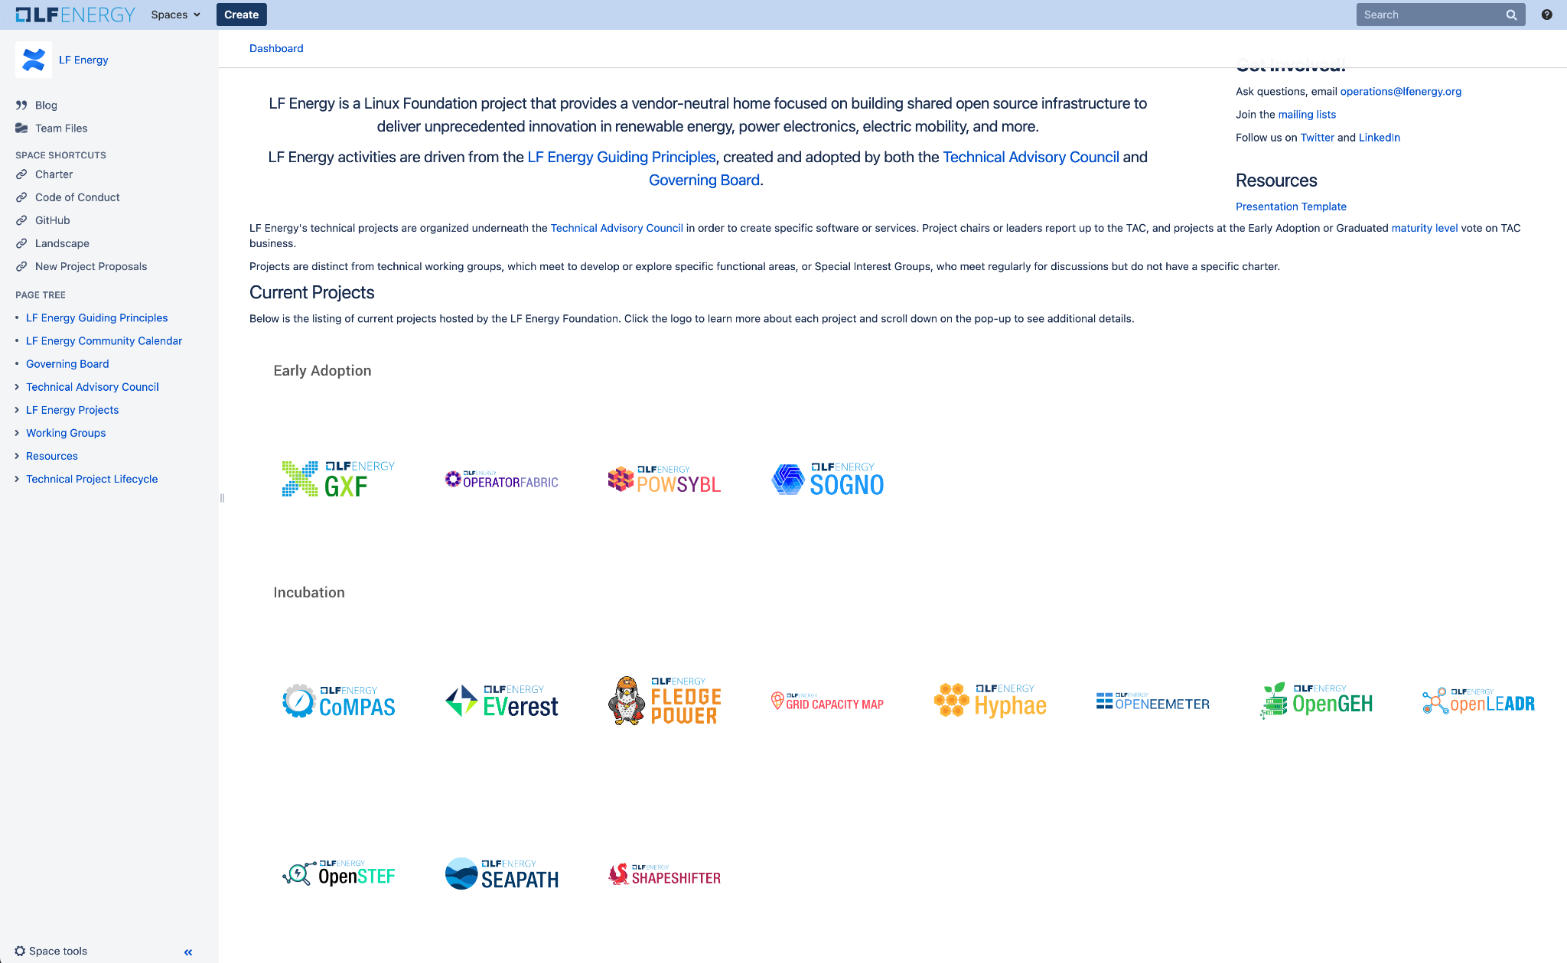
Transparency
All project governance documentation can be found at:
https://wiki.lfenergy.org/display/HOME/LF+Energy

Slide 47
Membership Model

Slide 48
Membership and Participation Levels
Membership Level | Annual Fee | Plus Linux Foundation Membership: Silver (if not a member) | Board Seat | TSC Seat | Outreach Committee | Suggested Minimum FTE* | Notes
Strategic | Flat fee: $150k | $20k | Yes | Yes | Yes | 1 | Two year minimum commitment
General | $5k-50k based on org size¹ | Based on number of employees $20K (5000+) $15K (499-4999) $10K (100-499) $5,000 (0-99) | (Possible) 1 per every 10 General members | Based on Merit | Yes | N/A | A TSC seat may be earned by technical contribution as a project leader
Associate | No fee | No | (Provisional at start-up) | Based on Merit | Yes | N/A | Limited to academic, research and NGO organizations
General Annual Fee Scale
$50K - > 5,000 employees
$30K - 1,000 – 4,999 employees $20K - 200 – 1,000 employees
$10K -100 – 200 employees
$5K -< 100 employees
* FTE = Full Time Equivalent (e.g. 2 employees each spend 50% of their time on a project). This suggestion is meant to provide a minimum resource investment to ensure members are contributing technically. Most projects see much higher investment of resources than the minimum requirement.

Slide 49
LF Energy Membership Benefits
Tier | New to LF | Existing LF member | Benefits
Strategic | $170,000 | $150,000 | Appoint one (1) voting representative to the LF Energy Governing Board. Appoint one (1) voting representative to the LF Energy Technical Advisory Council (TAC) Appoint one (1) representative as a voting member in any subcommittees or activities of the Governing Board. Enjoy most prominent placement in displays of membership including on the website and in marketing materials. 1 guest LF Energy blog post per quarter 1 LF Energy hosted webinar per quarter 1 Linux.com blog post per year 10 complementary LF Training course/certification tickets Create an individualized press release to announce membership with LF Energy PR. Receive greater insight into LF Energy strategy and project roadmaps through increased engagement with the LF Energy Executive Director and staff. Receive ongoing, monthly 1:1, individual engagement and guidance from LF Energy Executive Director Increased access to invitation-only Linux Foundation Member Summit. Receive discounts on LF Energy conferences + event sponsorship.
General | $70,000 (USD) 5,000+ $40,000 (USD) 2,000 – 4,999 $25,000 (USD) 500 – 1,999 $15,000 (USD) 100 – 499 $10,000 (USD) Up to 99 | $50,000 (USD) 5,000+ $25,000 (USD) 2,000 – 4,999 $10,000 (USD) 500 – 1,999 $5,000 (USD) 100 – 499 $5,000 (USD) Up to 99 | (Possible) Governing Board seat 1 per every 10 General and Academic and Research Institutions members collectively as a class, with a maximum of 3. 1 guest LF Energy blog post per year 1 LF Energy hosted webinar per year 10 complementary LF Training course/certification tickets Participate in all marketing, community, thought leadership opportunities. Receive discounts on LF Energy conferences + event sponsorship. Identify your organization as a member and display your logo on the LF Energy website and in marketing materials. Access to The Linux Foundation’s invitation-only Linux Foundation Member Summit.
Non-Profit | Free | Free | The Non-Profit category of membership is limited to non-profit/non-governmental organizations. This requires approval by the Governing Board. Participate in all marketing, community, thought leadership opportunities. Receive discounts on LF Energy event sponsorship. Identify your organization as a member and display your logo on the LF Energy website and in marketing materials.

Slide 50
For Further Information
Shuli Goodman
Executive Director Linux Foundation Energy sgoodman@lfenergy.org
Our Website: https://lfenergy.org
Membership: https://www.lfenergy.org/join
Mailing Lists: https://lists.lfenergy.org
Our Wiki: https://wiki.lfenergy.org

